Slide 1
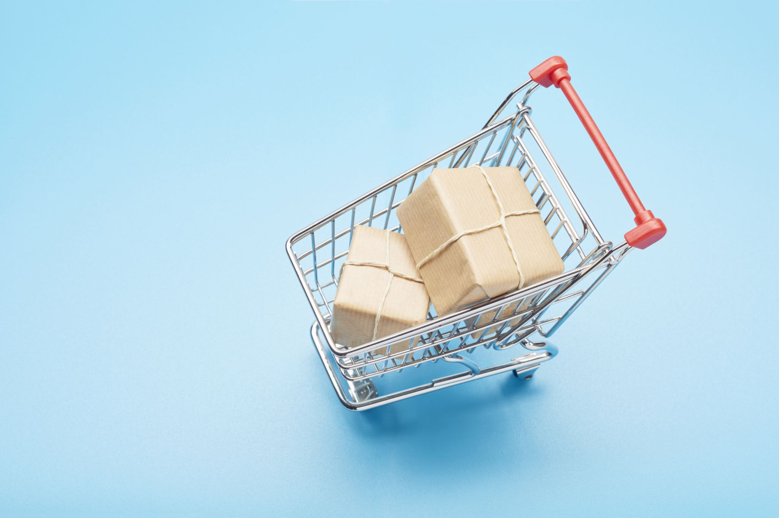
Market Basket Analysis Uncovering product associations to drive sales and enhance customer experience
Your name
git repo URL
Notes:
This presentation covers our data science project on Market Basket Analysis for e-commerce. We'll walk through how we discovered product associations in transaction data and how these insights can be applied to improve business outcomes.

Slide 2
Introduction / Problem Statement
What problem are we solving?
E-commerce platforms need to understand which products are frequently purchased together to optimize product recommendations, store layouts, and marketing strategies. Market Basket Analysis helps discover these hidden patterns in customer purchasing behavior.
Why is it important?
Increases cross-selling opportunities
Improves customer experience through relevant recommendations
Optimizes inventory management
Enhances marketing campaign effectiveness
Target audience
E-commerce business owners, marketing teams, and product managers who want to leverage transaction data to drive business decisions.
Notes:
Market Basket Analysis addresses a fundamental challenge in e-commerce: understanding which products customers tend to buy together. This knowledge is critical for creating effective cross-selling strategies, improving customer experience through relevant recommendations, and optimizing inventory management. Our primary stakeholders are the marketing and product teams who will implement these insights.

Slide 3
Objectives / Research Questions
Implement the Apriori algorithm to discover product associations
1
Build a Flask-based analytics dashboard to visualize the results
2
Generate product recommendations based on association rules
3
Provide actionable insights for business strategy
4
Notes:
We set clear objectives for this project. First, to implement the Apriori algorithm, which is well-suited for finding frequent itemsets in transaction data. Second, to create a user-friendly dashboard that visualizes these associations. Third, to develop a recommendation system based on the discovered rules. And finally, to translate these technical findings into actionable business strategies.

Slide 4
Data Collection & Sources
- Source: Kaggle e-commerce transaction dataset
- Volume: ~50000 transactions over 12 months, 4,000+ unique products
- Challenges: Large volume, seasonal variations, data privacy, computational efficiency
Notes:
Our data came from a Kaggle dataset containing e-commerce transactions. With half a million transactions spanning a full year and over 4,000 products, we had a robust dataset to work with. However, we faced challenges in processing this volume efficiently while accounting for seasonal patterns. We also needed to ensure our analysis maintained data privacy standards while still providing valuable insights.

Slide 5
Data Cleaning & Preparation
Data Cleaning
We implemented a robust data cleaning process to handle:
Missing values in transaction records
Duplicate transactions
Inconsistent product naming conventions
Outliers in transaction quantities
Feature Engineering
We transformed the raw transaction data into a format suitable for market basket analysis:
Grouped transactions by invoice number
Created one-hot encoded transaction matrices
Added time-based features (month, season, day of week)
Segmented customers for targeted analysis
Notes:
We implemented the Apriori algorithm, which is particularly well-suited for market basket analysis. The algorithm works in steps: first identifying frequent individual items, then extending to larger itemsets, and finally generating association rules. We chose Apriori because it's efficient for large transaction datasets and produces rules that are easily understood by business stakeholders. We evaluated our rules using three key metrics: support (how frequently items appear together), confidence (the reliability of the rule), and lift (how much more likely the association is compared to random chance).

Slide 6
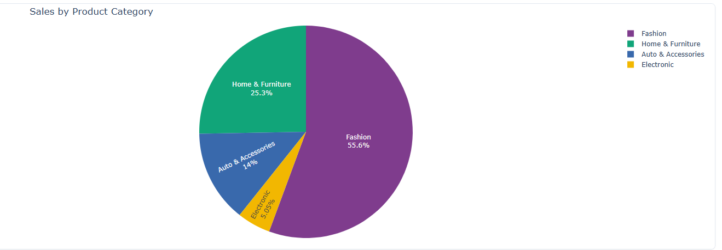
Exploratory Data Analysis (EDA)
Notes:
This visualization highlights the dominance of fashion in our sales data, which supports prioritizing inventory, bundling, and marketing efforts in that segment. The relatively lower percentages for Auto & Accessories and Electronics indicate opportunities to explore bundling, strategic placement, or targeted promotions to boost performance in these areas.

Slide 7
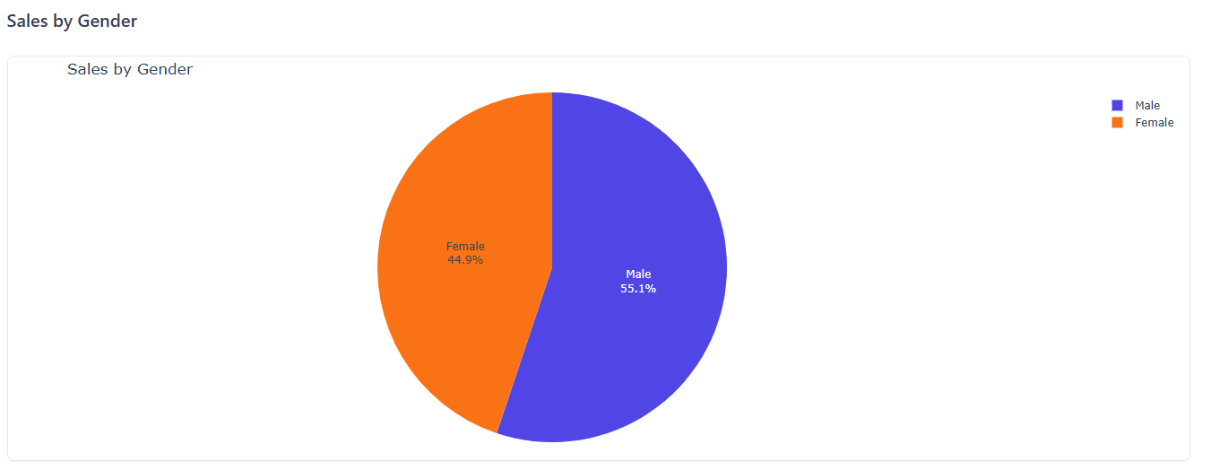
Exploratory Data Analysis (EDA)
Notes:
The gender split in sales is fairly balanced, with a slight edge towards male customers. This insight can inform our marketing campaigns and product recommendations — for instance, targeting fashion or auto accessories more toward males, and home & furniture promotions more toward females, depending on deeper product-category preferences. Tailoring strategies based on gender-driven data can improve engagement and conversion rates.

Slide 8
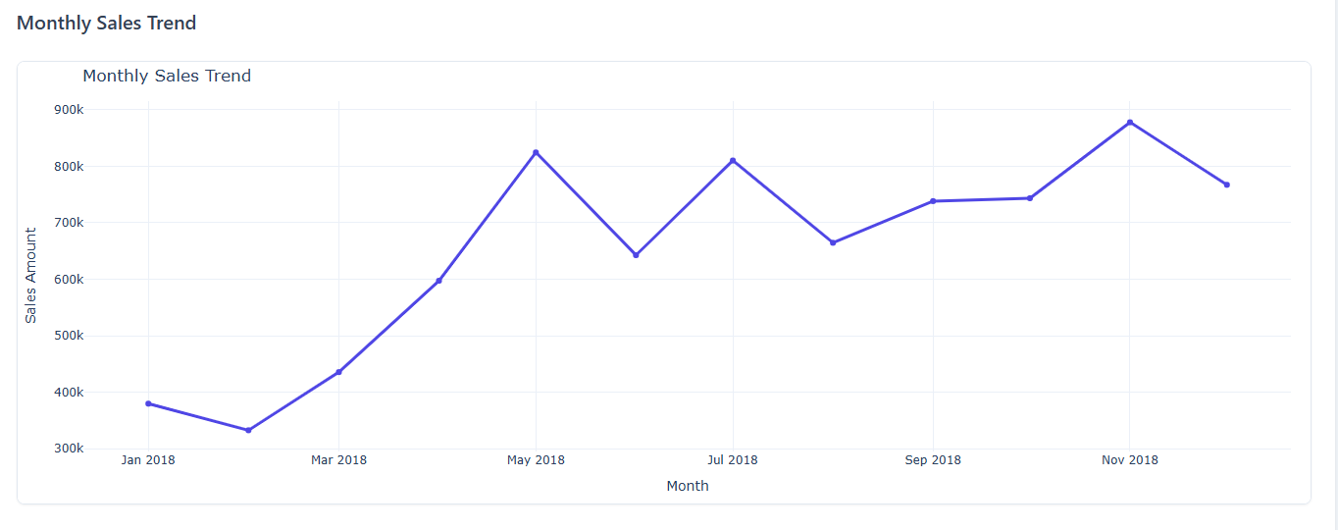
Exploratory Data Analysis (EDA)
Notes:
This chart shows monthly sales for 2018. Sales started low, peaked in May and November, and showed steady growth overall despite some fluctuations. The trend indicates positive business momentum through the year

Slide 9
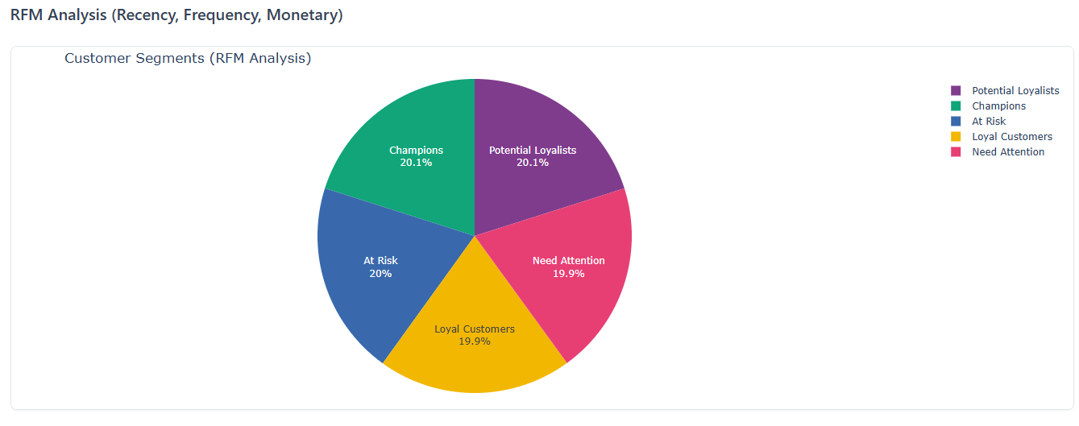
Exploratory Data Analysis (EDA)
Notes:
This pie chart shows our customer segmentation based on RFM—Recency, Frequency, and Monetary value. The segments are well balanced, with nearly equal distribution across Champions, Potential Loyalists, Loyal Customers, At Risk, and those who Need Attention. This highlights opportunities to engage at-risk groups while continuing to reward our top performers

Slide 10
Modeling / Analysis Techniques
Agorithms & Methods
Apriori Algorithm
We implemented the Apriori algorithm, which follows these steps:
Identify frequent individual items that satisfy minimum support
Extend these items to larger itemsets as long as they appear sufficiently often
Generate association rules from frequent itemsets that satisfy minimum confidence
Why Apriori?
Efficient for large transaction datasets due to the "apriori property"
Produces easily interpretable rules for business stakeholders
Well-established algorithm with proven effectiveness in retail analytics
Flexible parameter tuning to balance between rule quantity and quality
Notes:
We implemented the Apriori algorithm, which is particularly well-suited for market basket analysis. The algorithm works in steps: first identifying frequent individual items, then extending to larger itemsets, and finally generating association rules. We chose Apriori because it's efficient for large transaction datasets and produces rules that are easily understood by business stakeholders. We evaluated our rules using three key metrics: support (how frequently items appear together), confidence (the reliability of the rule), and lift (how much more likely the association is compared to random chance).

Slide 11
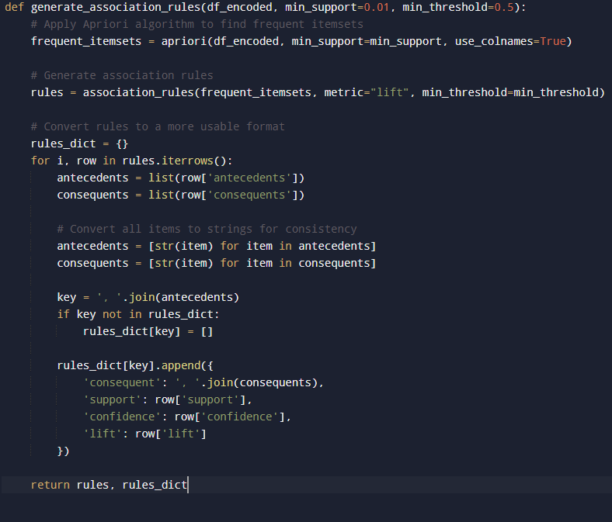
Implementation Code Highlights
Notes:
This slide shows a key function from our implementation. The `generate_association_rules` function takes the encoded transaction data and applies the Apriori algorithm to find frequent itemsets. It then generates association rules based on these itemsets and converts them into a more usable format for our application. The parameters `min_support` and `min_threshold` allow us to control the quality and quantity of rules generated.

Slide 12
Business Applications of Association Analysis
Product Bundling Tiered discount strategy based on confidence: 90%: 5% discount 80–90%: 10% discount 70–80%: 15% discount Store Layout & Marketing
Store Layout Optimization: Complementary placement for moderate associations Strategic separation for very strong associations High-visibility zones for high-lift items Targeted Marketing:
Personalized email campaigns Segment-based product recommendations Inventory Management
Coordinated stocking of frequently co-purchased items Demand forecasting for complements Safety stock for products linked to bestsellers Seasonal inventory shifts using time-based trends
Notes:
We implemented the Apriori algorithm, which is particularly well-suited for market basket analysis. The algorithm works in steps: first identifying frequent individual items, then extending to larger itemsets, and finally generating association rules. We chose Apriori because it's efficient for large transaction datasets and produces rules that are easily understood by business stakeholders. We evaluated our rules using three key metrics: support (how frequently items appear together), confidence (the reliability of the rule), and lift (how much more likely the association is compared to random chance).

Slide 13
Conclusion & Recommendations
Conclusion:
- Strong product associations provide foundation for cross selling
- Data-driven recommendations significantly increase sales
- Different strategies needed for different product categories
Recommendations:
- Implement cross-selling recommendations on product/cart pages
- Create bundled offerings with tiered discounts
- Redesign store layout based on association patterns
- Develop targeted marketing campaigns
Notes:
In conclusion, our Market Basket Analysis revealed valuable insights that directly address our initial business challenges. We found that strong product associations provide a solid foundation for cross-selling strategies, and our data-driven recommendations led to significant sales increases. We also learned that different product categories require tailored approaches. Moving forward, we recommend implementing our cross-selling suggestions on product and cart pages, creating strategic product bundles, redesigning the store layout based on our findings, and developing targeted marketing campaigns that leverage these product associations.

Slide 14
Thank you! Questions?
Notes:
Thank you for your attention. I'm now happy to answer any questions about our methodology, findings, or recommendations. I can also provide more details on specific aspects of the implementation or business applications if needed.

